Slide 1
Obama Speech Analysis
Sihan Wang

Slide 2
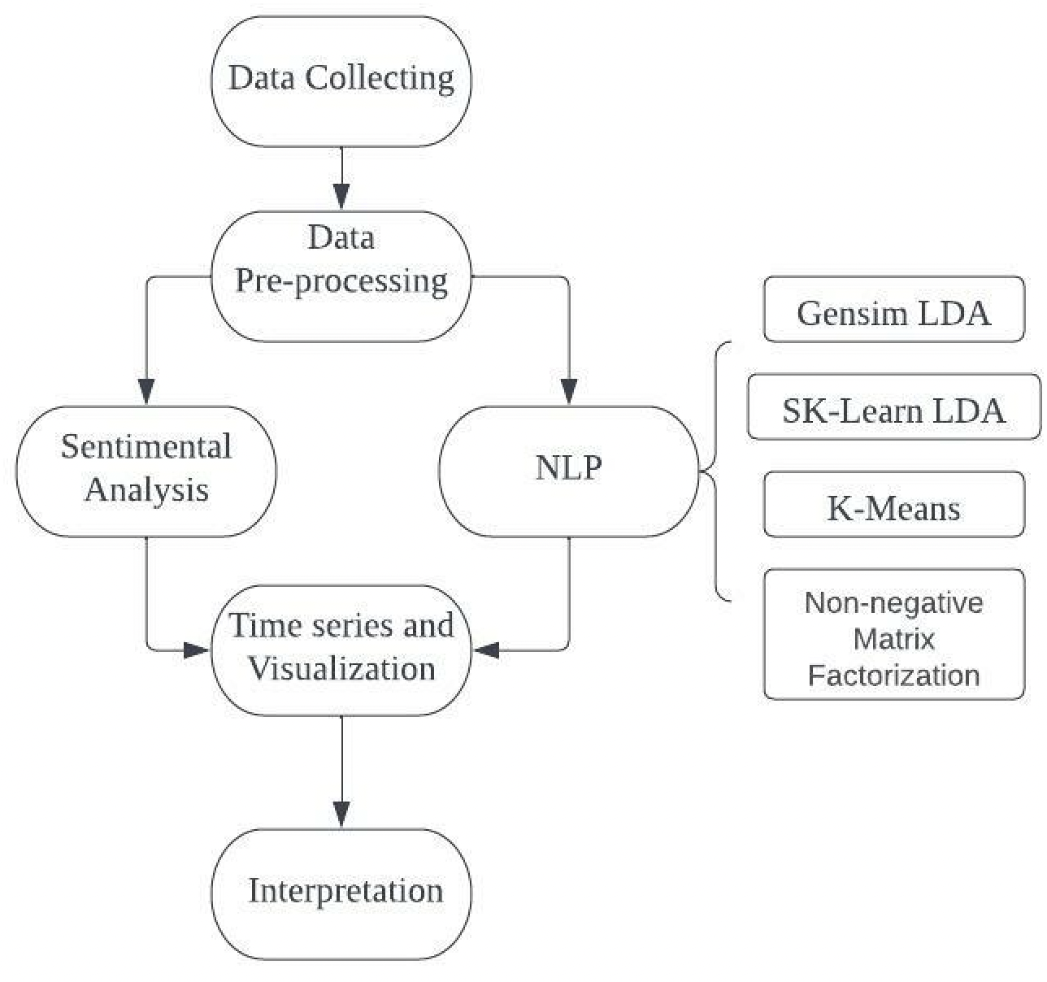
Speech analyzing procedures
Data collection
Data cleaning
NLP with different methods
Sentimental Analysis
Time Series plot
Topic Modeling Visualization
Conclusion

Slide 3
Data Collecting and Pre-processing

Slide 4
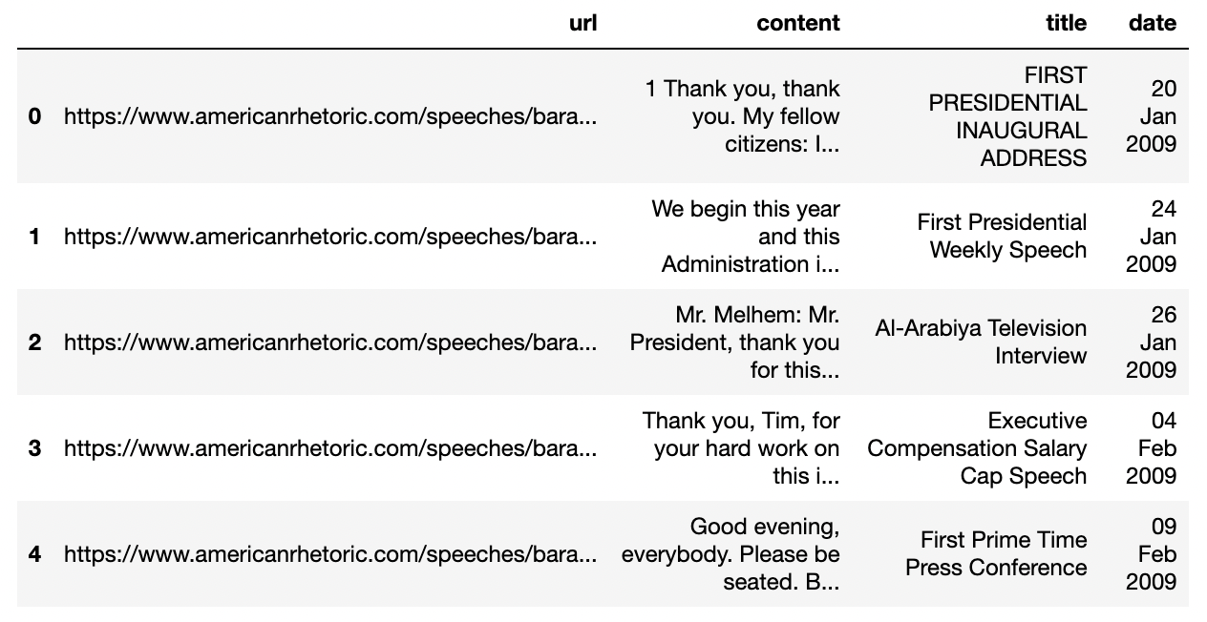
Data Collecting
BeautifulSoup to fetch the URL of each speech
BeautifulSoup to extract the title,
date, and content of each speech

Slide 5
Data Pre-processing
Regular expression and nltk tokenizer
– Remove all punctuations, numbers, special characters, then lowercase
Stemmer
– Lower the inflation of words into root words by cutting the prefix and suffix
Word Lemmatizer
– Classify the nouns and verbs in the speeches

Slide 6
NLP Topic Modelling

Slide 7
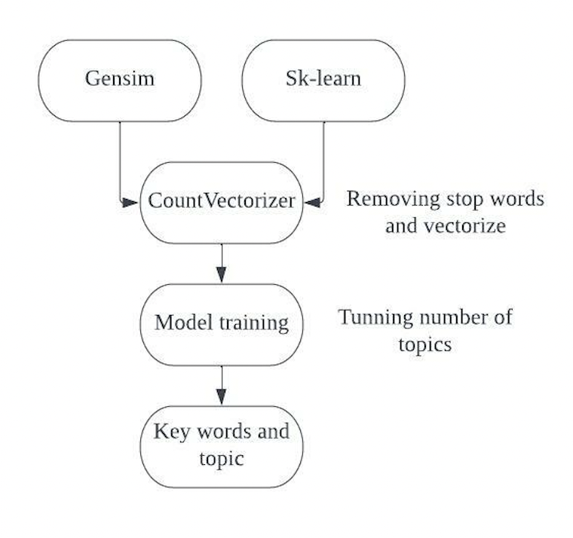
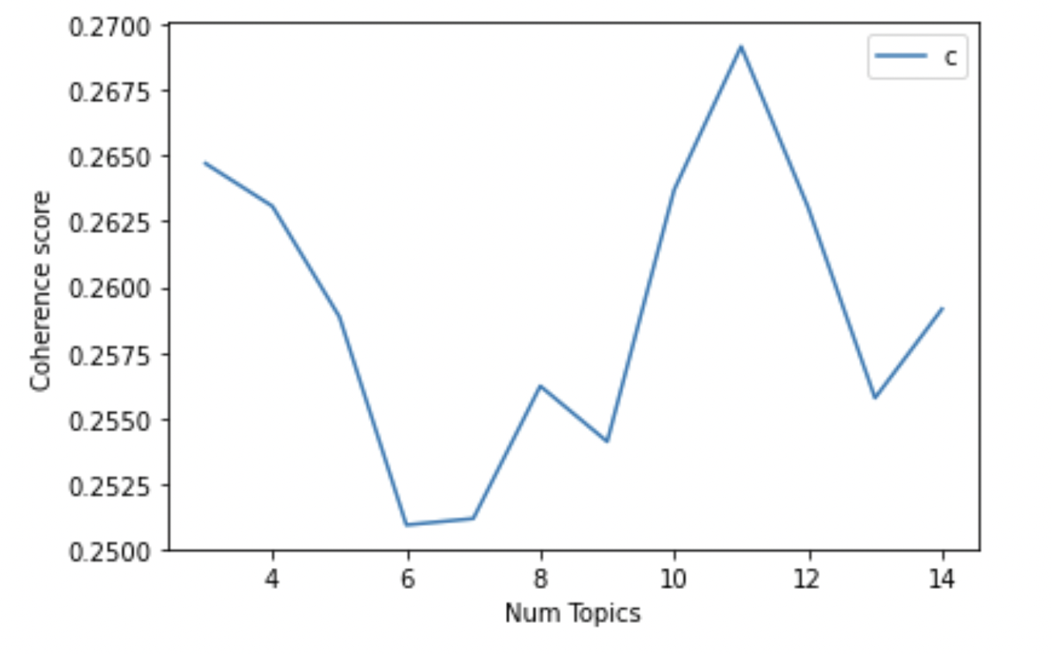
Models: Gensim and Sk-Learn
Model procedure Optimal topic number = 11

Slide 8
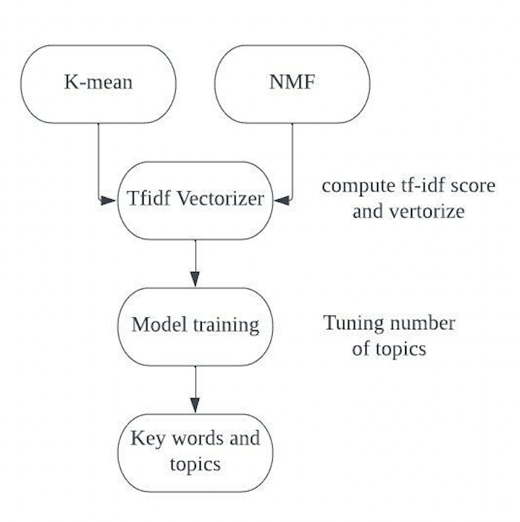
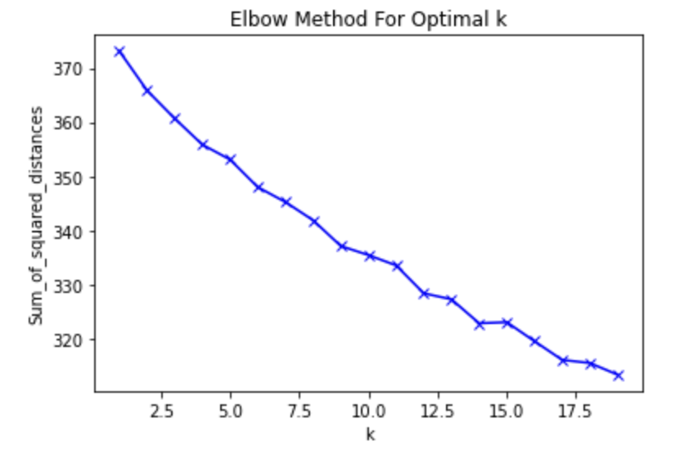
Models: K-mean and NMF
Model procedure Optimal topic number (no clear answer)

Slide 9
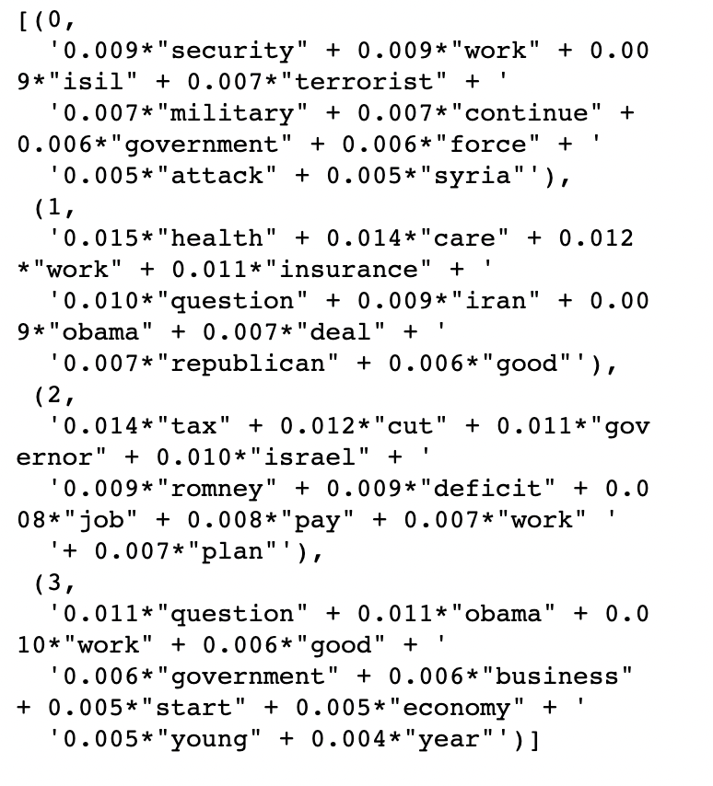
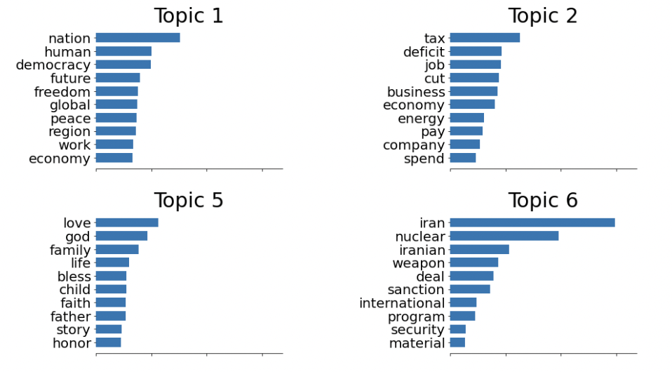
Result of topic modeling
Output of Gensim model Output of NMF model

Slide 10
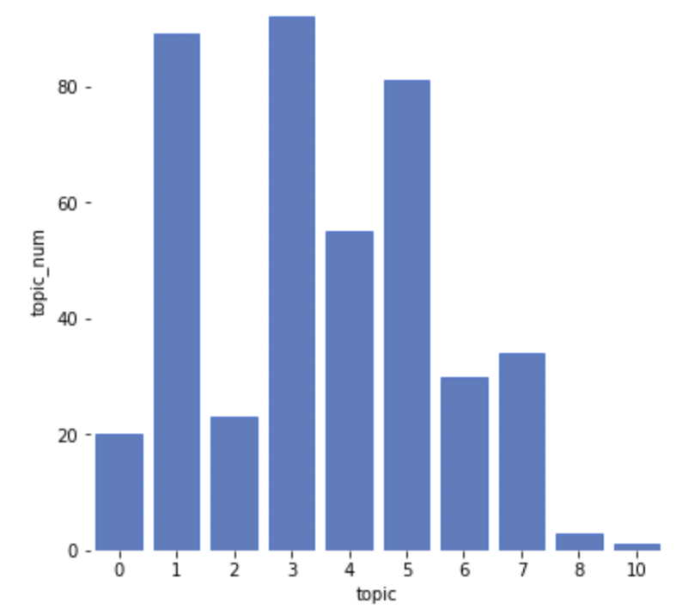
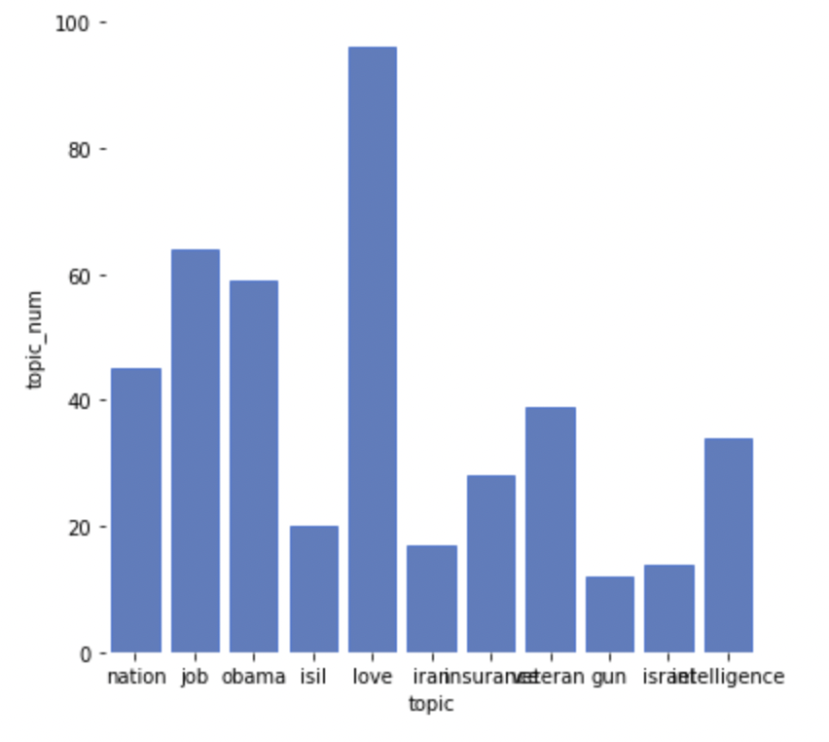
Count Topic
Result of Gensim Result of NMF

Slide 11
Sentimental Analysis

Slide 12
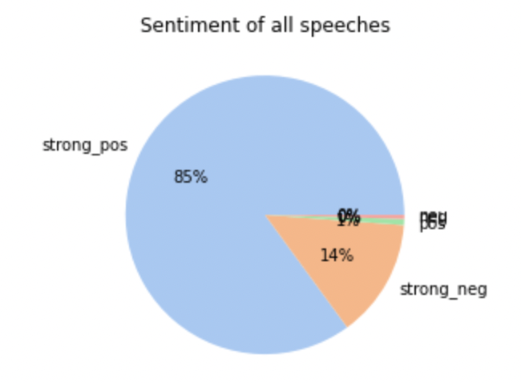
Overall Sentiments
Strong Positive: 364
Positive: 3
Neutral; 0
Negative: 2
Strong Negative: 59

Slide 13
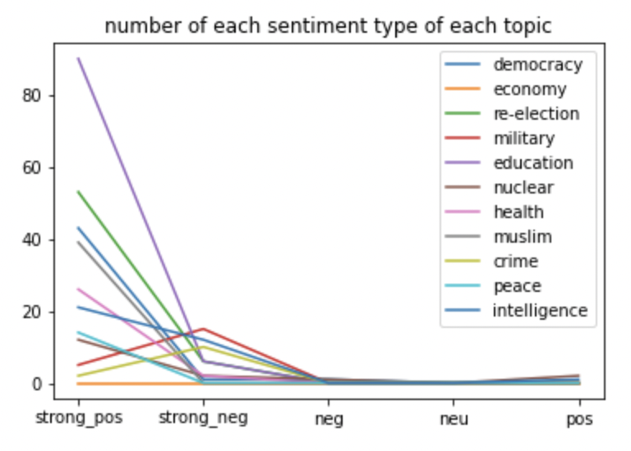
Sentiments for each topic
Most of the topics have more positive sentiment
Military topic has strongest negative sentiment compare to other topics
When talking about democracy, health care, labour, economy and education, Obama had more optimistic tone

Slide 14
Topic visualization

Slide 15
Topics
Democracy and Human Rights Freedom
Economy and job opportunities
Obama’s second presidential election
Education and family
Nuclear war in Iran
Military force and threat to Muslims in Iraq, Isil etc.
Health Care issues
Criminal Law and violence
Intelligence security and surveillance

Slide 16
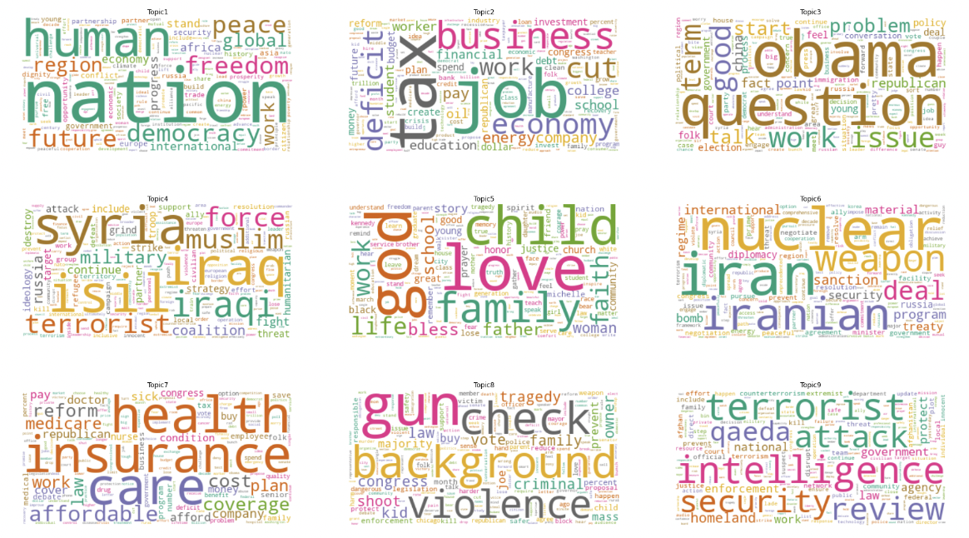

Slide 17
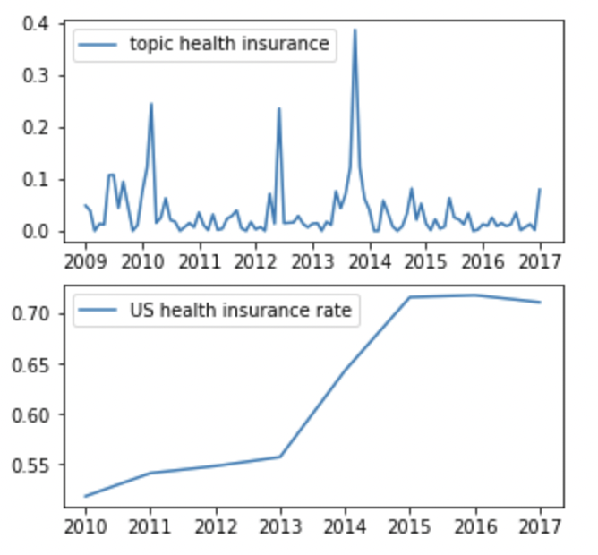
Health Care
Important events happened between 2011-2013:
Health Care Reform Bill
Affordable Care Act
Obama's speech had a significant influence on promoting health care in the United States, which was fairly reasonable given that health care was his major political accomplishment.
Notes:
There is a high degree of similarity in the trends of these two curves,

Slide 18
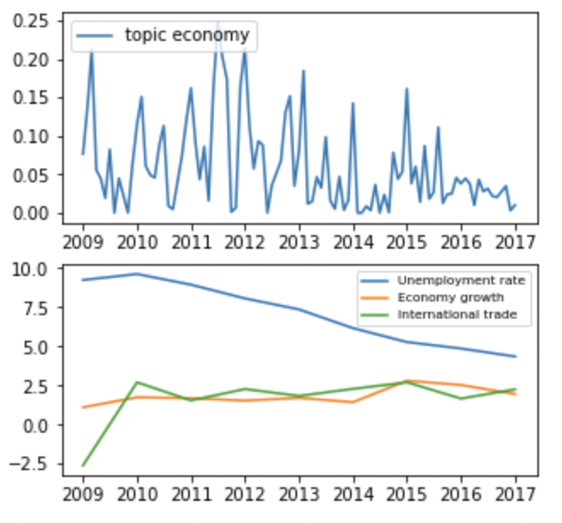
Economy and Employment
Important events happened between 2009 - 2012:
American Recovery and Reinvestment
American Job Act
Another of Obama's accomplishments is to the U.S. economy and jobs. As a result of his proposals and speeches, the unemployment rate has greatly decreased, and the country's economy and global trade have slowly increased.

Slide 19
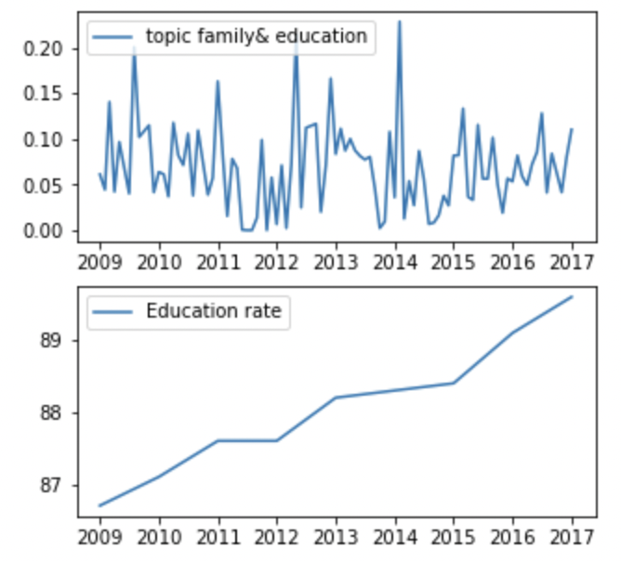
Education
Important events happened between 2009-2014:
Veteran education reform
No child left behind law
Children in America now have more access to school, and the advancement of American education has been accelerated by Obama's remarks and actions to bring about official education reform.

Slide 20
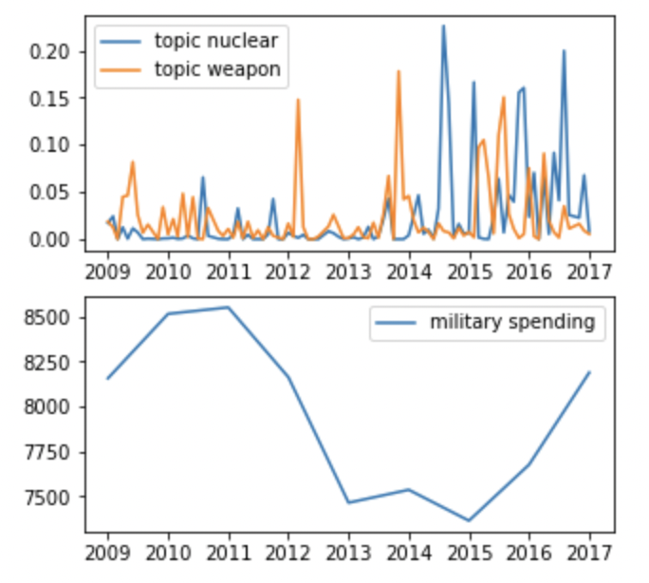
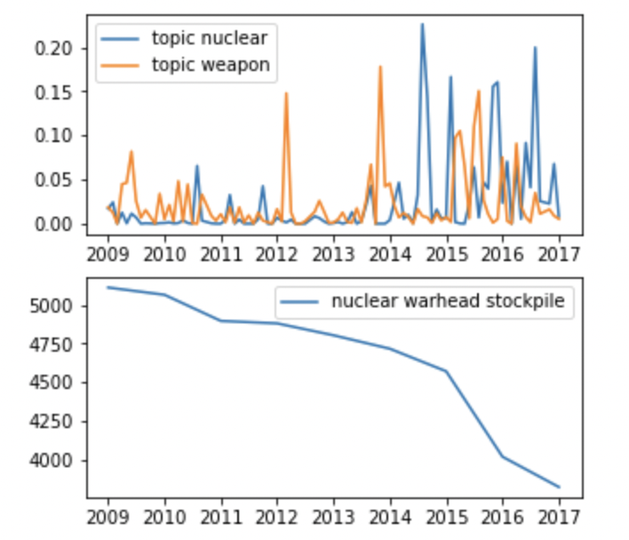
Military Spending

Slide 21
Conclusion

Slide 22
Summary
Data preparation: BeautifulSoup, and NLTK
Topic Modelling: Gensim LDA, Sk-Learn LDA, K-Means, and NMF
Sentimental Analysis: Textblob, and SentimentIntensitAnalyzer
428 Obama speeches can be classified into approximately 9 clusters
Most of his speeches are about democracy, economy, health care
Obama’s speeches are more positive
Trend of crime rates and health care coverage in the United States have high similarity to Obama's speech during 2009 to 2017.

Slide 23
Thanks for listening

